Slide 1
Chat-bot
資工三 林靖紳

Slide 2
Table of Contents
Project Goals
Project Requirements
Value of Implementation
Implementation
Expected Results
Reference

Slide 3
Project Goals

Slide 4
Project Goals
Design a real-time and intelligent text Chat-Bot on https://embedded.cs.ccu.edu.tw/center/#/
Target audience: Taiwanese and Indian projects seekers
Main purpose:
This is a platform for matching talents from Taiwan and India
Users look for projects on the platform
Users can explain their requirements for seeking their wanted project such as types, salary, project duration, etc.

Slide 5
Project Requirements

Slide 6
Requirements
User request analysis
Identify the user intent
Extract relevant keywords
Returning the response
Real-time response
The answer can be briefly divided into:
A generic predefined text (e.g. Hi, Thank you, etc.)
Data stored in backend (e.g. Find projects according to users’ requirements)

Slide 7
Value of Implementation

Slide 8
The Value of Implementation
Enhance customers experience
Real-time service
Improve customers engagement process
operational efficiency
Optimize cost
Automatic service replace traditional service agents

Slide 9
Implementation

Slide 10
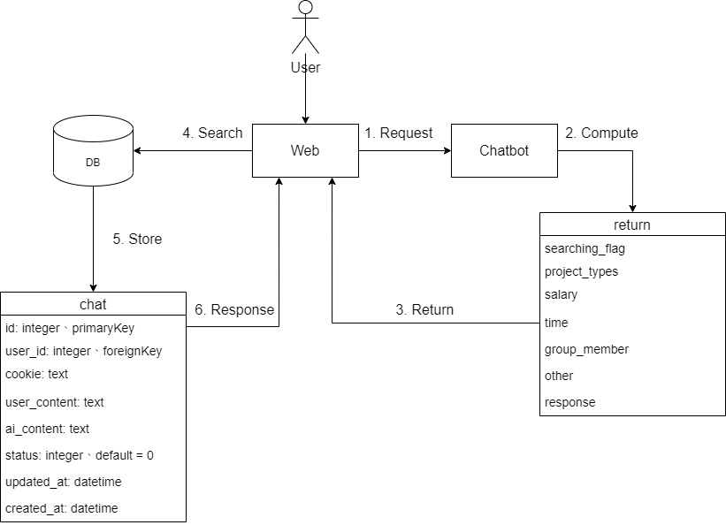
Structure Diagram

Slide 11
Requirements
User request analysis
Identify the user intent
Extract relevant keywords
Returning the response
Real-time response
The answer can be briefly divided into:
A generic predefined text (e.g. Hi, Thank you, etc.)
Data stored in backend (e.g. Find projects according to users’ requirements)

Slide 12
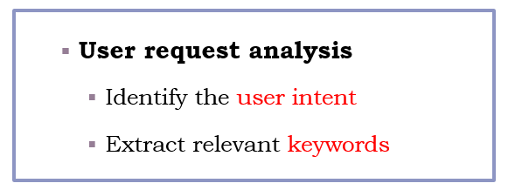
Nature Language Understanding
Intent classification
Slot filling
Label each word in a sentence

Slide 13
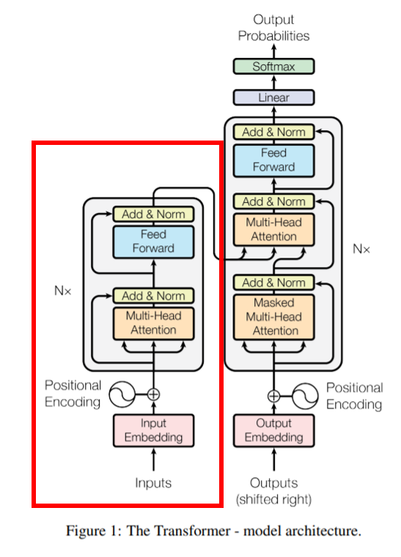
BERT
What’s BERT?
Bidirectional Encoder Representations from Transformers
A general language model for NLP tasks
Architecture
Multi-layer bidirectional Transformer encoder
Pre-trained -> fine-tuning
Notes:
先以 LM Pretraining 的方式預先訓練出一個對自然語言有一定「理解」的通用模型
再將該模型拿來做特徵擷取或是 fine tune 下游的（監督式）任務

Slide 14
How to implement BERT (1)
Input
A sequence of tokens
Two special tokens:
[CLS]
The first token of every sequence
Stands for classification token
[SEP]
At the end of a sequence
[CLS] | I | want | a | AI | project | [SEP]
I | want | a | AI | project
“I want a AI project”

Slide 15
How to implement BERT (2)
Output
Vector of size 768 in each of the tokens
1… 768
vectors
BERT
[CLS] | I | want | a | AI | project | [SEP]

Slide 16
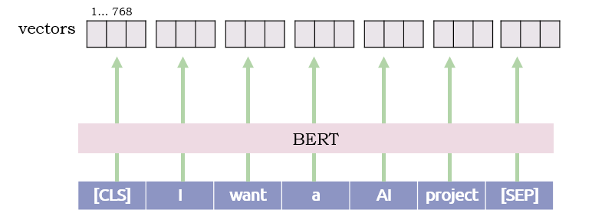
Fine-tuning Intent Classification
For a Intent Classification task, we focus on the vector of [CLS]
Find for project type
Classifier
Find for salary
Fond for project duration
Greeting

Slide 17
Fine-tuning Slot Filling
O: Other, this element doesn’t belong to any type
Find for Project type
B-Project type
O
O
O
O

Slide 18
Structure Diagram

Slide 19
Expected Result

Slide 20
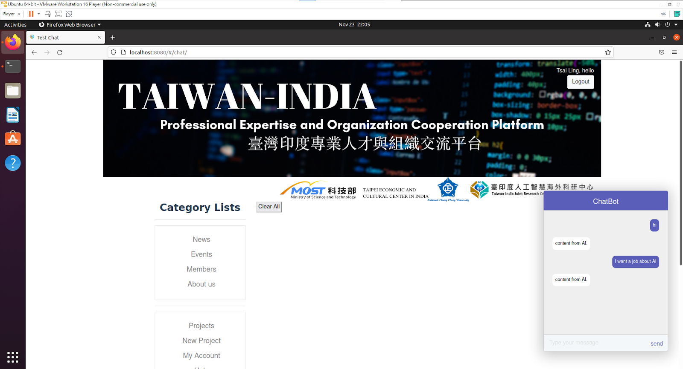
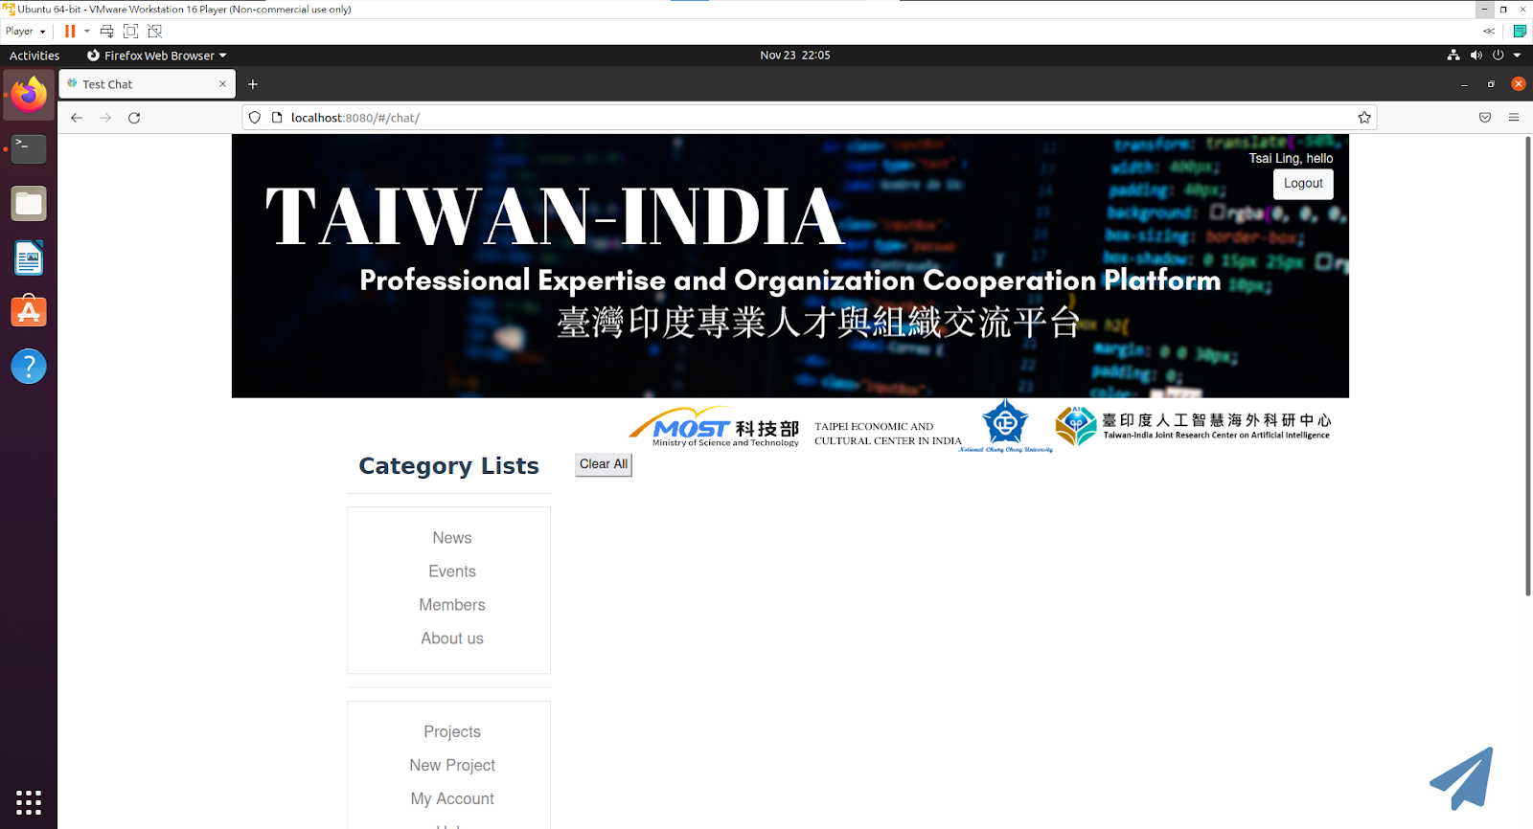

Slide 21
Bot
Hi
Hi! How may I help you
I want to find a project
Ok! Which project type would you like
Related to AI and IOT
Any conditions else?
Salary
Project duration.
No
Here are your searching results:
https://xxxx
send

Slide 22
Reference

Slide 23
Reference
https://arxiv.org/pdf/1902.10909.pdf
https://towardsdatascience.com/text-classification-with-bert-in-pytorch-887965e5820f
https://youtu.be/UYPa347-DdE
https://github.com/monologg/JointBERT

